Slide 1

e-Commerce Project Presentation
Christine
Komal Patil
Shriya Sharma

Slide 2



Our Team– group 7
Christine
Komal Patil
Shriya Sharma

Slide 3
Project TimeLine
Part-1
Brainstorming session on Project Ideas and Project Scope. Finalized the project scope, goals and deliverables
Part-2
April-2 to April-12
Transforming the strategy into a requirement.
Part-3
April-13 to April-26
Presentation on work completed till date
Part-4
Part-5
Delivered Project proposal.
Pre-processing the data and working on Analysis.
Working on the key deliverables and answering most of the deliverable questions.
April-27 to May-3
Working on the final deliverable questions and future scope of this analysis.
May-4 to May-10
Finalizing the Project Report and submission.
Feb-18 to April-1

Slide 4
Project Goal
Our eCommerce business analysis aims to optimize sales and revenue by implementing a recommendation engine based on customer behavior. To have an efficient supply chain operations. Also check with the inventory management, data analysis for pricing strategies, and fraud prevention measures through dataset analysis.

Slide 5
Key Deliverables
Building a recommendation engine for customers based on their behavior and preferences and having a targeted marketing.
Analyze the purchase Trend and manage the supply chain operations to have an effective inventory with accurate predictions.
Analyze the data and determine optimal pricing strategies for products.
To use the dataset to help detection of suspicious activity for fraud prevention measures.

Slide 6
Data Description
Data Size: 5GB
Data timeframe: This file contain behavior data for 2 months (October 2019 and November 2019) from a large multi-category online store.
Data Content: The dataset contains user activity data from a website that sells various products in different categories, such as electronics, home appliances, etc. The dataset includes columns for user ID, visit date and time, product category, user action (view, add to cart, buy), and item price. It also includes information about the user's location and the type of viewing device used.

Slide 7
Major Challenges
The size of the dataset is significant, and it includes a diverse range of data types, including customer behavior, product information, and transactional data. As a result, it may pose challenges in terms of data processing and analysis.
The dataset may be incomplete, contain inaccuracies, or inconsistencies, which can affect the reliability and precision of any analysis or modeling.
Integrating and combining diverse data sources can pose challenges, necessitating meticulous data mapping and transformation to ensure data accuracy and consistency.

Slide 8
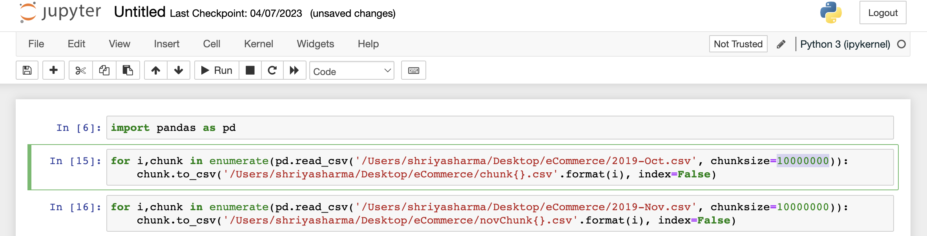
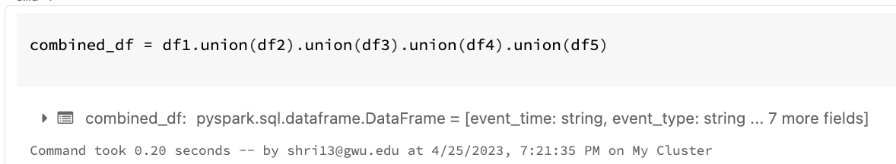
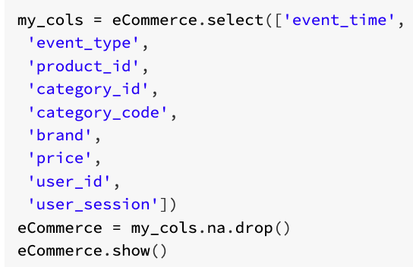
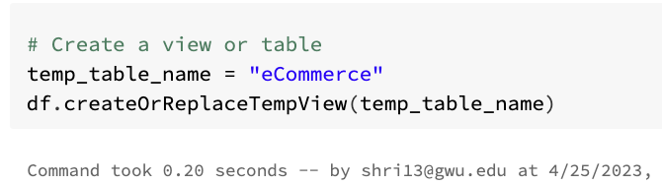
Data Pre-Processing
Utilized python to split the data of 2 months into 12 equal parts with 10,000,000 lines and 1.33 GB each.
We combined all the 12 parts using the “union” function.
Removed all the rows with Null values.
Created temporary view table for working on SQL Queries.

Slide 9
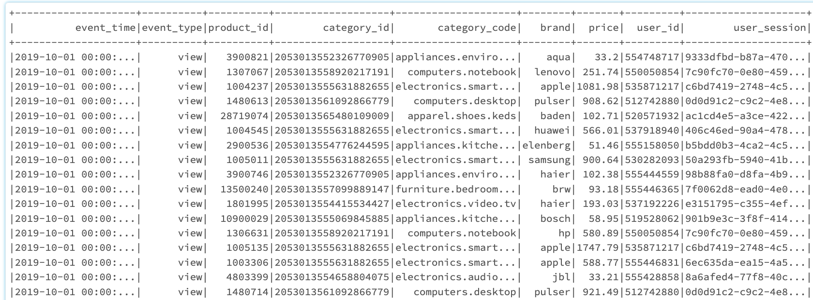
Ecommerce data summary

Slide 10

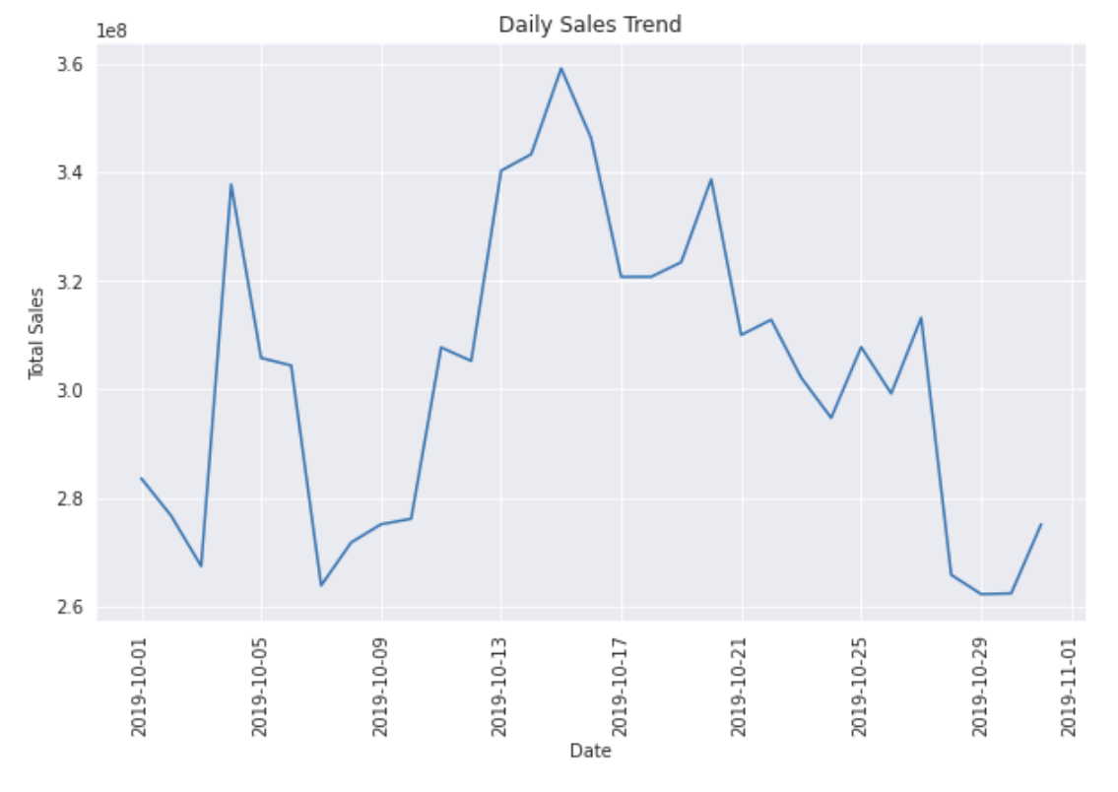
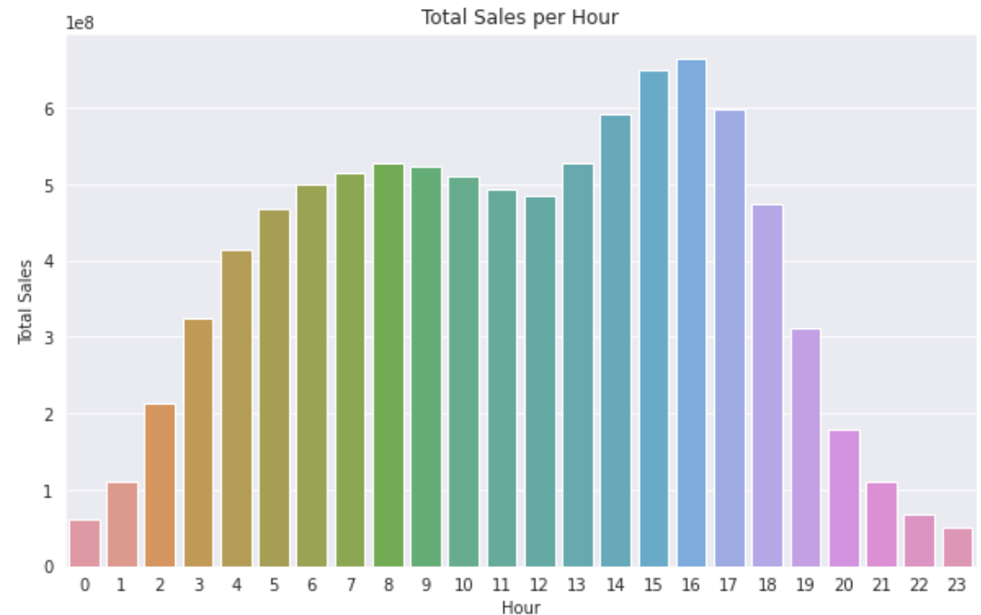
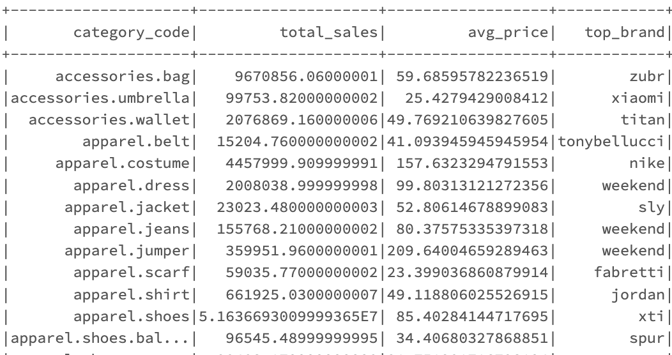
Trend analysis

Slide 11
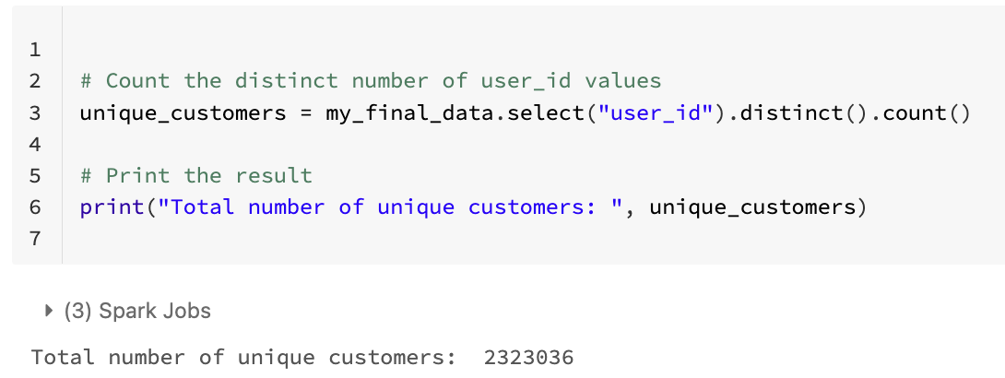
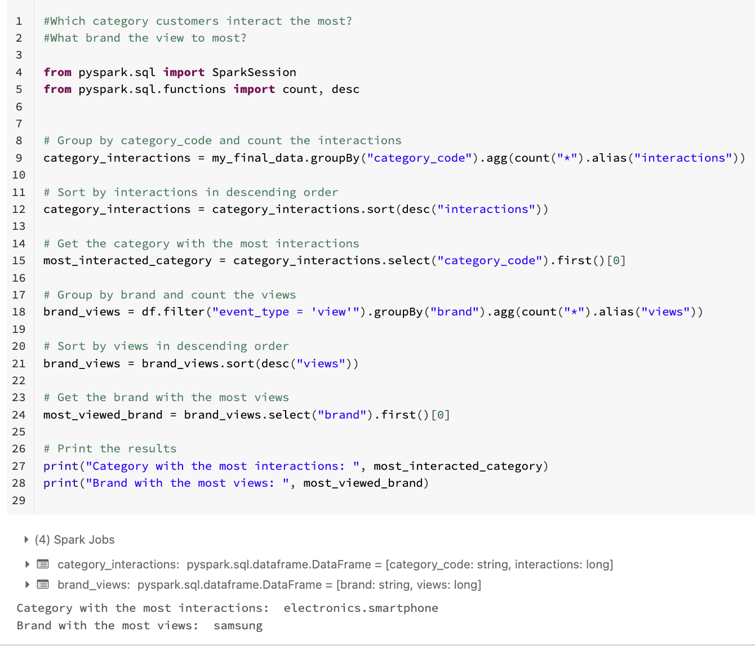
User analysis

Slide 12
DATA COMPARISON
Has our sales/revenue increased between the month of October and November?
Between the two months, which brand is our top selling brand and which e-commerce category do most customers interact with?
How many individuals have made a purchases or engaged with the e-commerce business between October and November?

Slide 13
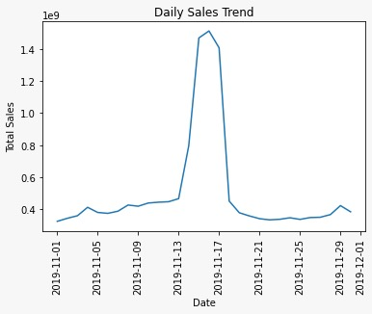
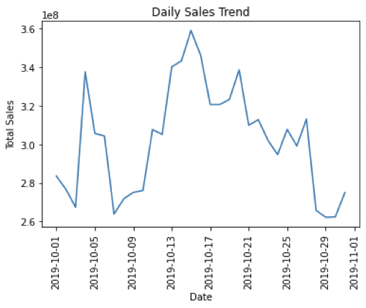
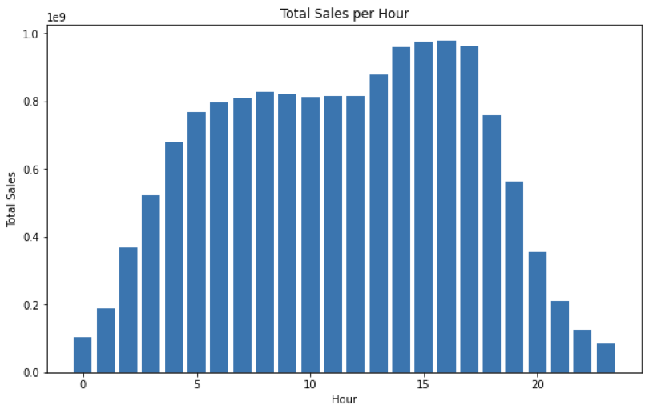
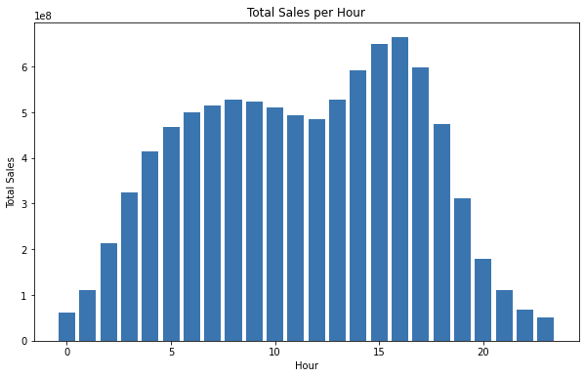
SALES ANALYSIS-oct-nov

Slide 14
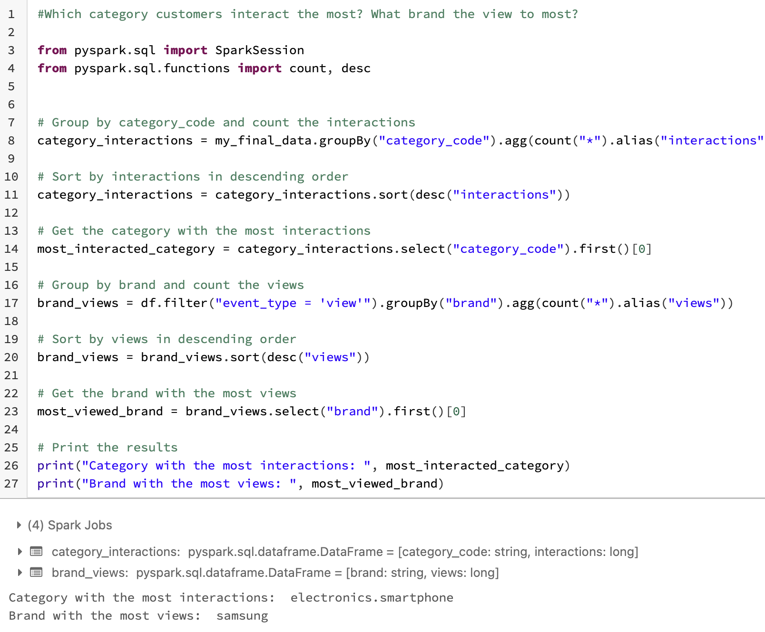
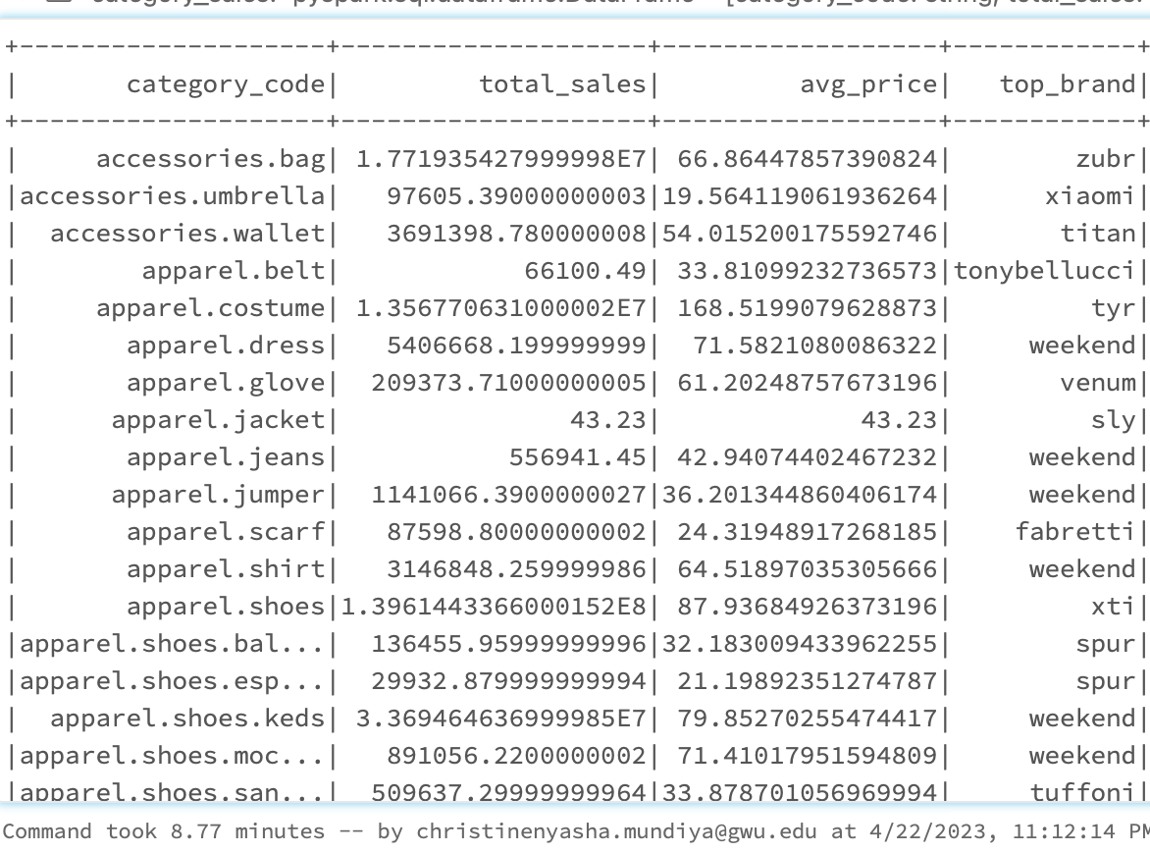
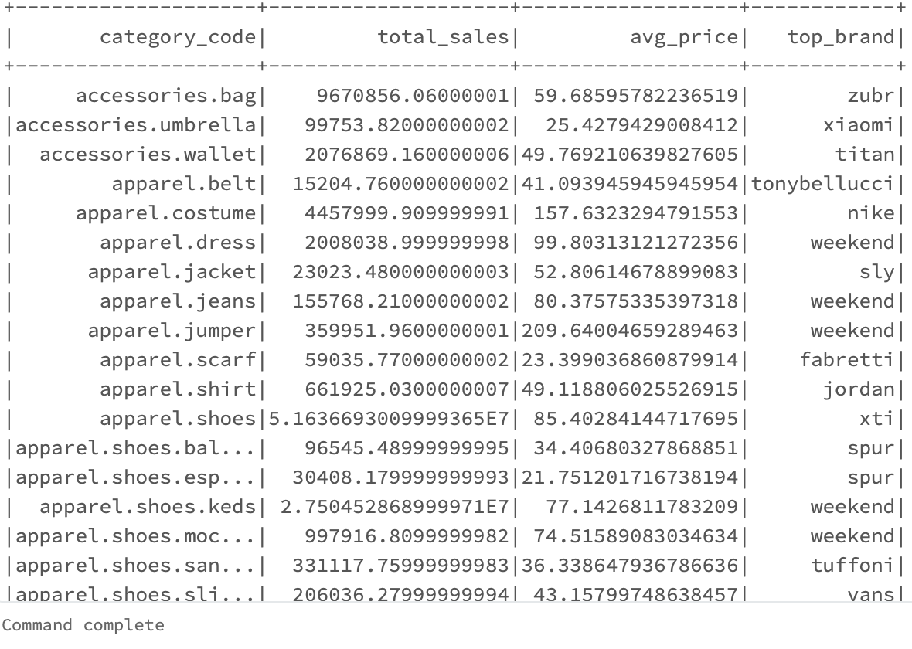
Brand analysis-oct-nov Note: Only showing first 18 rows

Slide 15
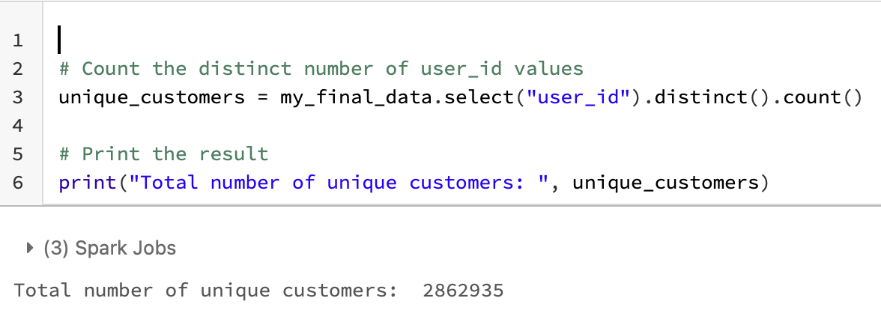
CUSTOMER ANALYSIS
Customer engagement and marketing strategies has been successful, and the overall size and growth of the customer base has increased

Slide 16
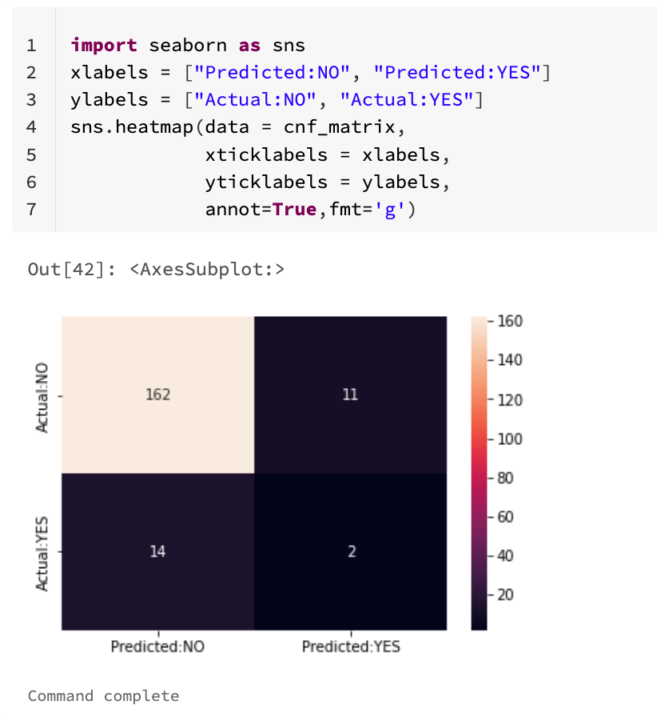
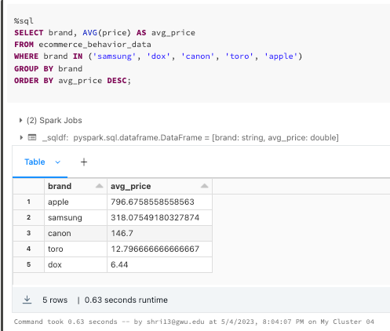
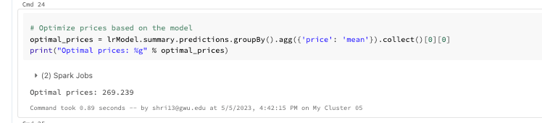
Price optimization…
price optimization, linear regression was used to identify the factors that have the greatest impact on price and to determine the optimal price for a given product. The independent variables could include product features, competitor prices, customer demographics, etc. The dependent variable would be the price of the product.
This analysis was utilized to predict the best price for a new product based on its specifications and other pertinent criteria. Therefore, in our study we are using this strategy to optimize prices in order to maximize earnings and acquire a competitive advantage in the market.

Slide 17
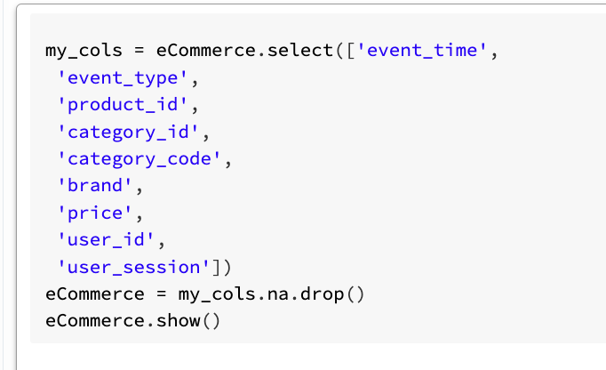
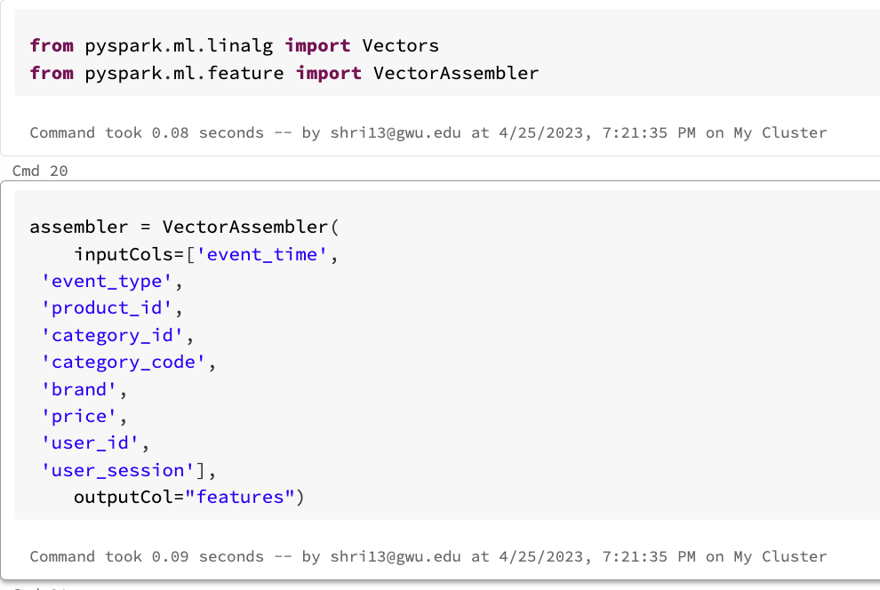
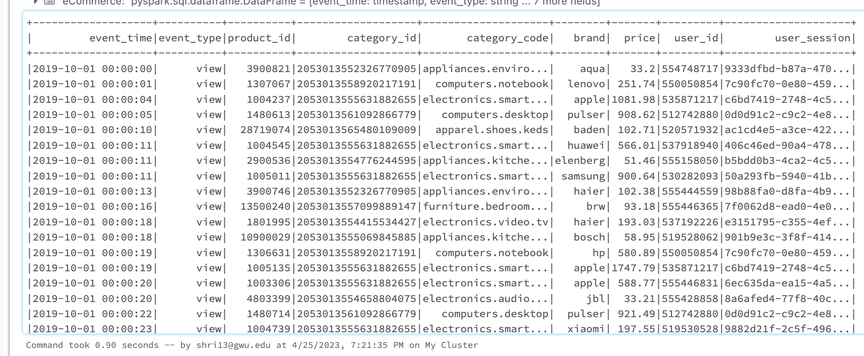
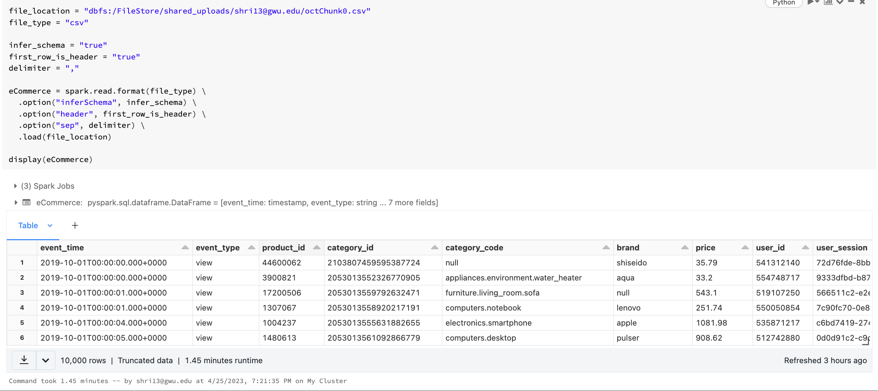
Regression Analysis…

Slide 18
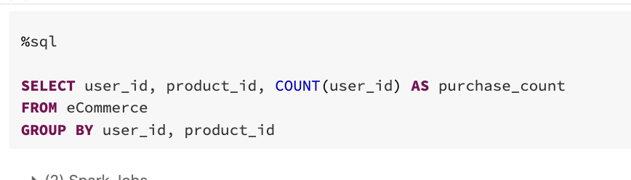
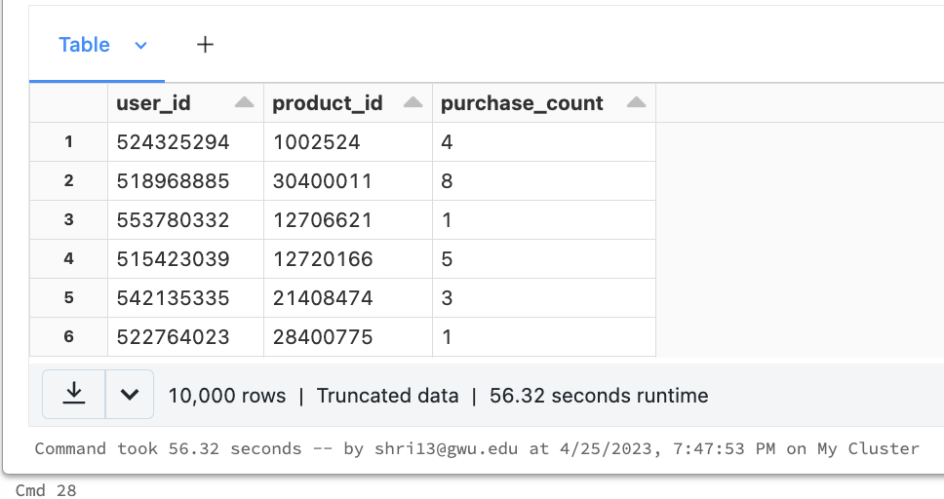
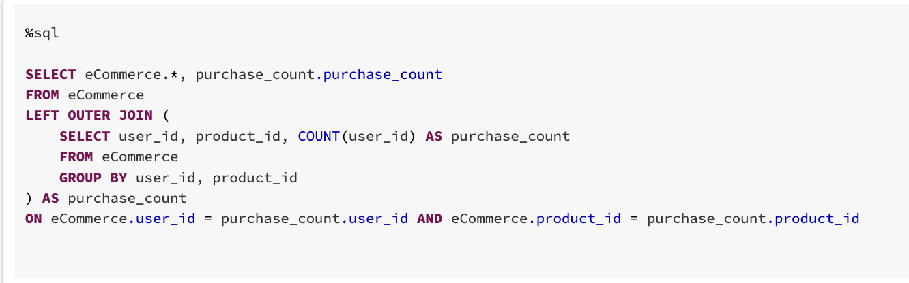
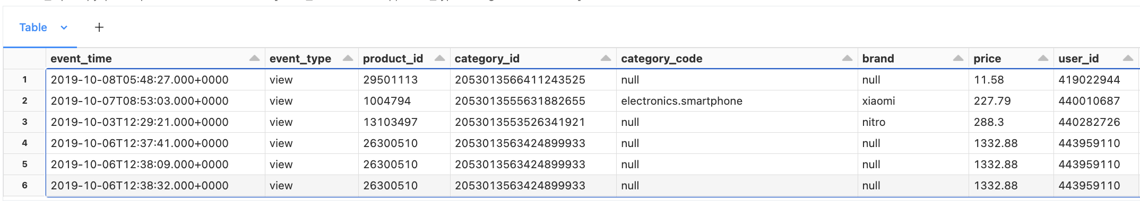
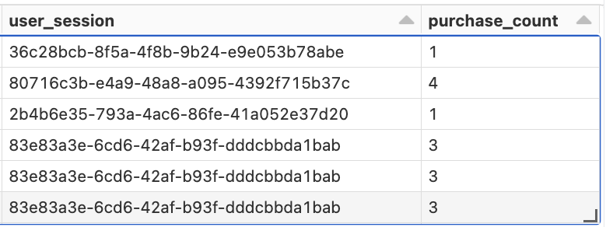
Using SQL Query to add in a new column purchase count for sales optimization analysis.

Slide 19
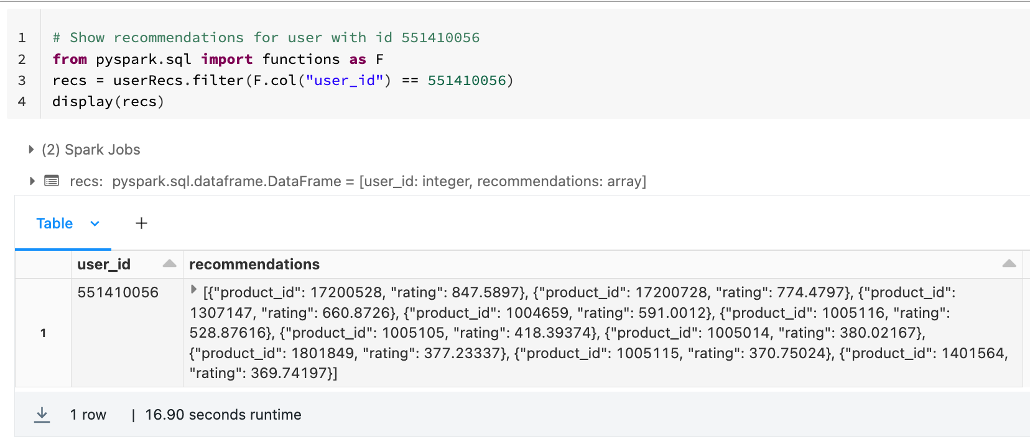
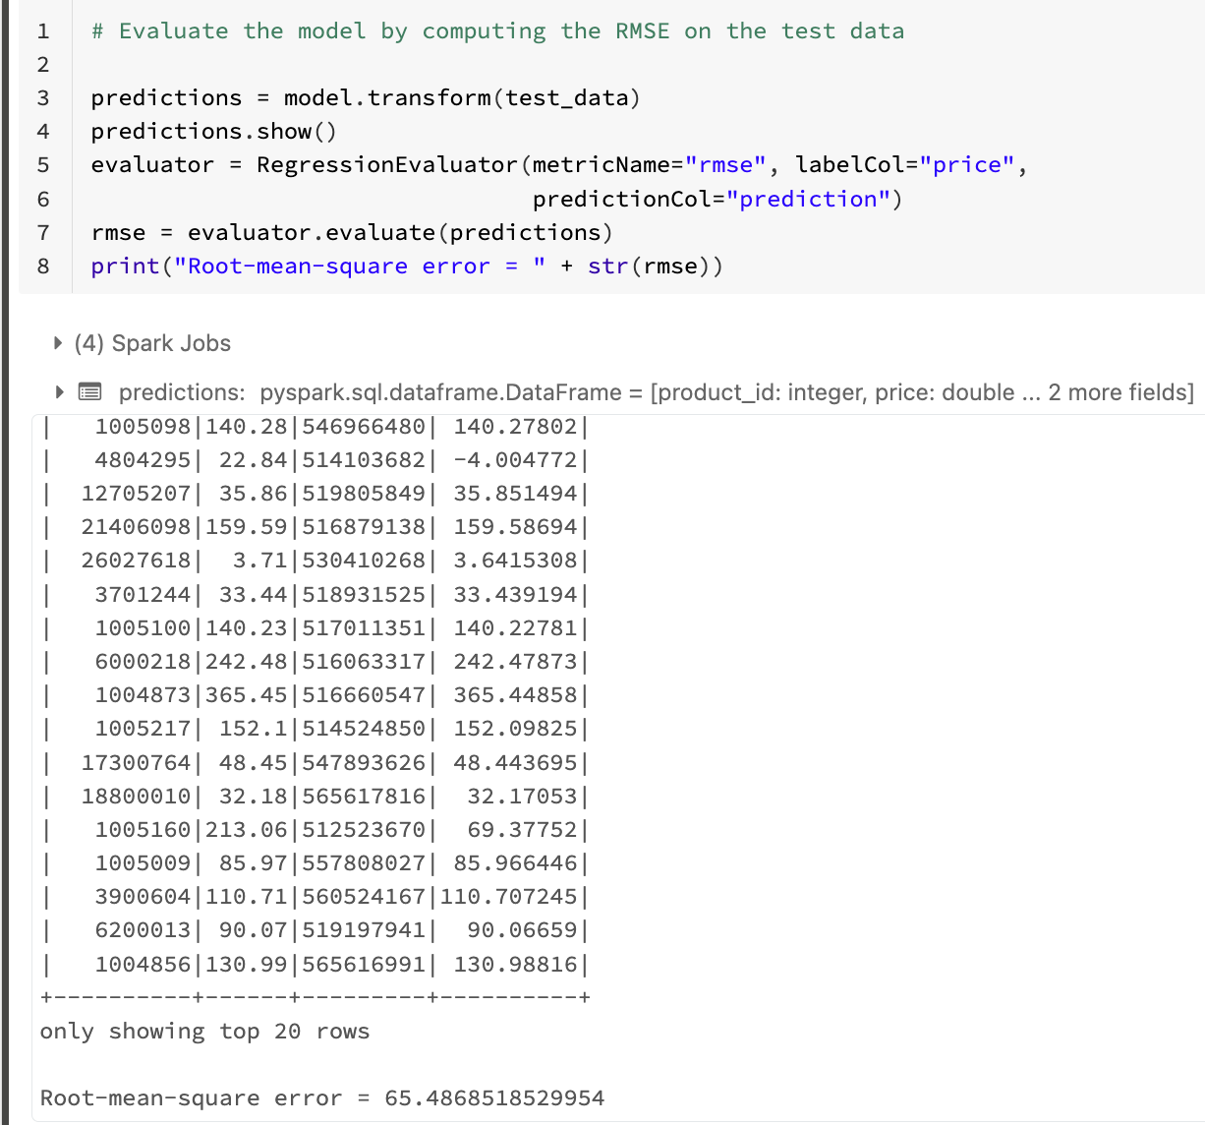
Recommendation system
A frequent collaborative filtering technique in recommendation systems is the ALS (Alternating Least Squares) model is used.
Based on each user's prior encounters with products, suggestions were then generated for them using the model. The user was shown the top recommendations in order of anticipated likelihood of purchase, which were rated recommendations. Using the root-mean-square error (RMSE) metric, which gauges the discrepancy between anticipated and actual ratings, the accuracy of the recommendation system was assessed

Slide 20
Work in progress…
To build a pricing strategy optimization based on product attributes and customer behavior based on the product purchase count. Also have a targeted recommendation engine.
Using Linear Regression, we would predict the demand of a product and make sure that we have our inventory managed.
Detection of suspicious activity for fraud prevention measures. For this we need to track the users who make purchases that are much larger or smaller than the typical purchase, or who make purchases at unusual times based on the user session information.
Use of this analysis.

Slide 21

Thank You..!! Any questions….

